Slide 1
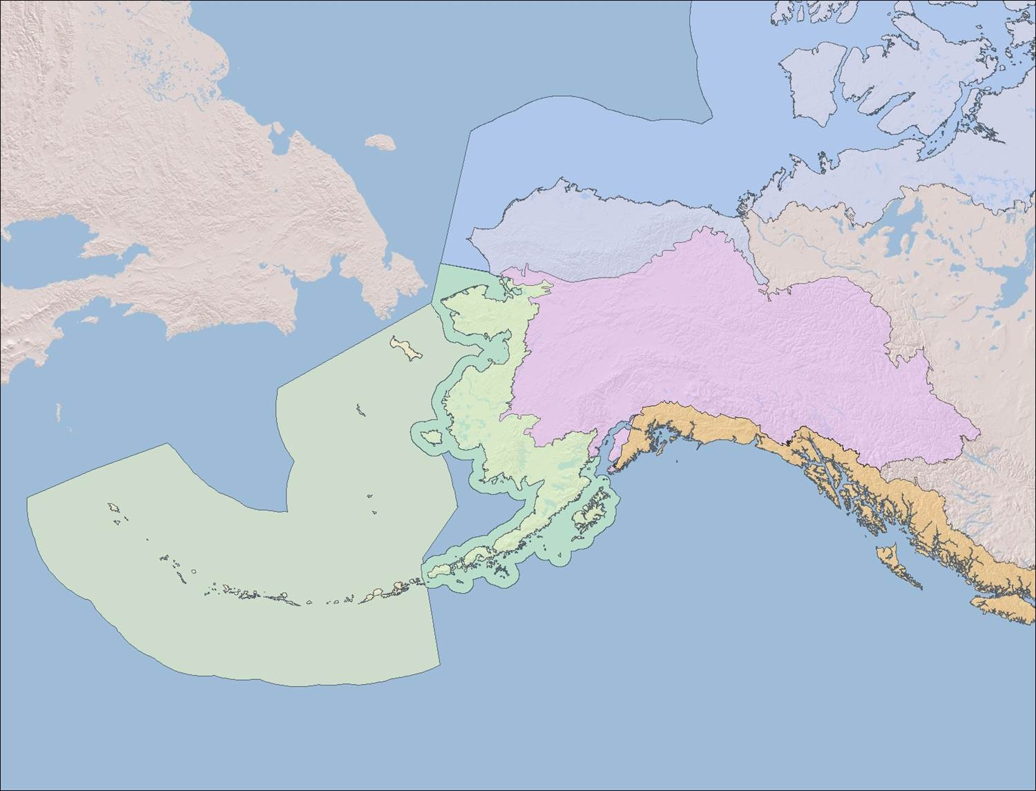
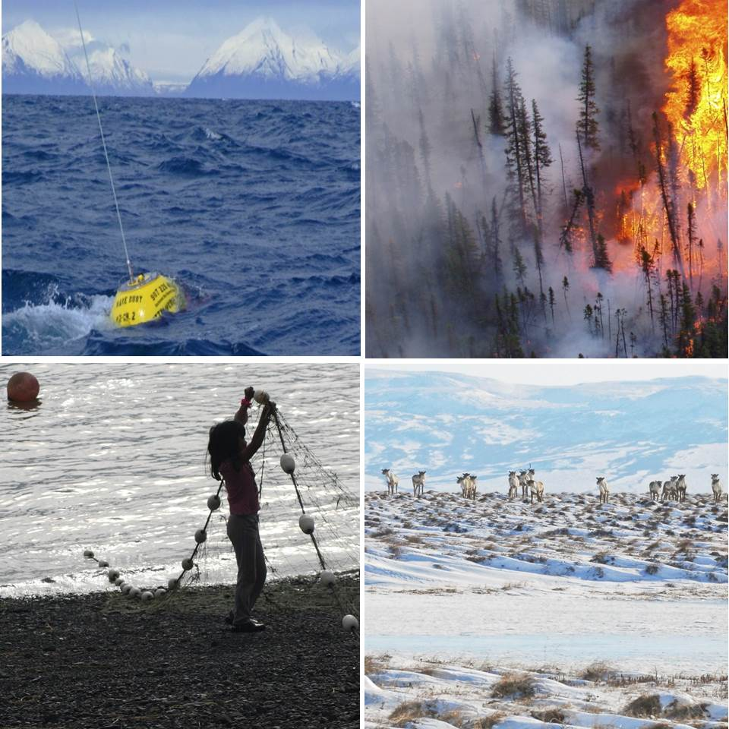
The Alaska LCCs’ Webinar Series
Today: David Atkinson Univ. of Victoria
18 Feb 2015 – Kimber DeGrandpre – Relative Sea Level Change in Western Alaska as Constructed with Satellite Altimetry and Repeat GPS Measurements
Notes:
RECORD
Universal mute –
Under 'Participants', select either 'Mute All' or 'Mute on Entry', then I can selectively unmute folks.
Muted Participants can use '*6' to unmute themselves and ask a question.
28 Jan 2015 - Atkinson/ Eerkes-Medrano webinar
JOEL REYNOLDS JOEL_REYNOLDS@FWS.GOV; Suzanne Worker
David Atkinson datkinso@uvic.ca; Laura laura.em.ca@gmail.com; Rose Fosdick rfosdick@kawerak.org;
Becki Heim rebecca.heim@noaa.gov; john mark jmark.nvk@gmail.com; Aimee Fish aimee.fish@noaa.gov;
Renee Tatusko renee.l.tatusko@noaa.gov Alex alexander.gould@alaska.gov
karen murphy karen_a_murphy@fws.gov

Slide 2
Categorization of slush-ice berm formation on the west coast of Alaska
David Atkinson University of Victoria, Dept. of Geography
Call in: 1-866-730-5871; access code: 111111
Please mute your phone except to ask questions, etc.
Notes:
David is a professor in the Department of Geography at University of Victoria, a position he has held since 2010. For the six years prior to that, he was a research scientist and professor at UAF’s International Arctic Research Center/Department of Atmospheric Sciences. He also held Post-Doc positions at Bedford Institute of Oceanography, focusing on environmental forcing of arctic coastal regions (2002-2004), and the University of Ottawa, focusing on high-arctic data issues and computer methods for hemispheric paleo-climate reconstruction (2000-2002). His PhD focused on high-arctic climate issues . His primary interests centre around the "environmental forcing" of coastal zones and the analysis of large-scale weather patterns that cause problems for people on the ground - communities, industry, operations. Typically this means addressing how storm winds affect coastal zones via "ocean states" - that is, the severe waves or storm surges that they cause. In the north, this also includes giving special attention to the unique complicating conditions introduced by the presence of sea-ice and frozen ground. To this end, interdisciplinary partnerships are a key element of his work. His work encompasses investigating high-latitude storm and storm track dynamics, the response of the ocean surface to winds, statistical characterization of extreme events. He conducts field work in communities in the Alaska and Canadian North as well as icefields in the Rockies. At UVic he teaches undergraduate & graduate courses on climate and synoptic weather topics and mentors a growing number of graduate students.

